Slide 1
Enhancing copies in the Core of Relational Databases
August 29th, 2022

Slide 2
01 – Previous meeting wrap up
02 – Task completion
03 – Current status
04 – Next steps

Slide 3
01
Previous meeting wrap up

Slide 4
Previous meeting comments
Forgetting in the copy model was described.
We propose a regularization term to mitigate it.

Slide 5
03
Current status

Slide 6
Current Status
01
UCI databases
02
Custom loss function and train step functions

Slide 7
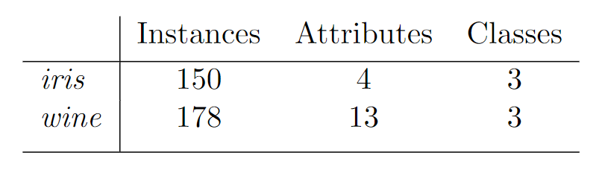
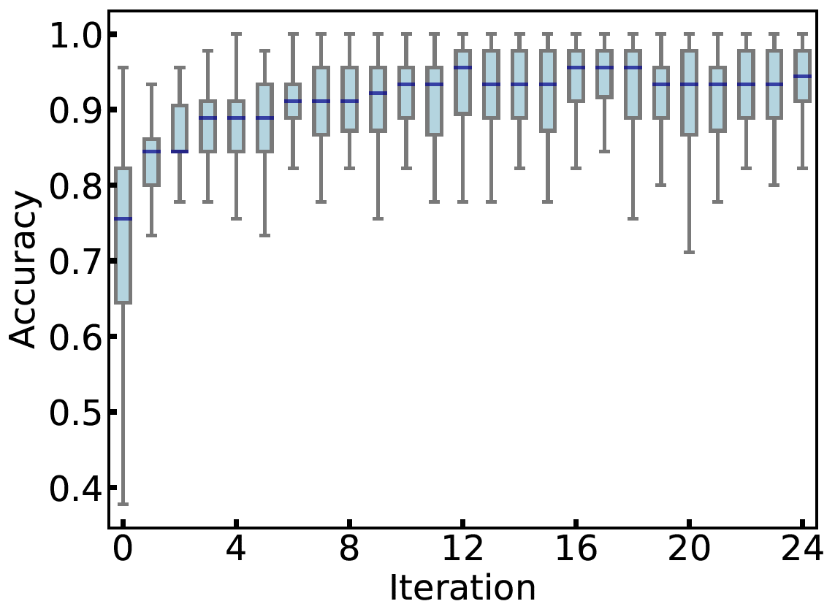
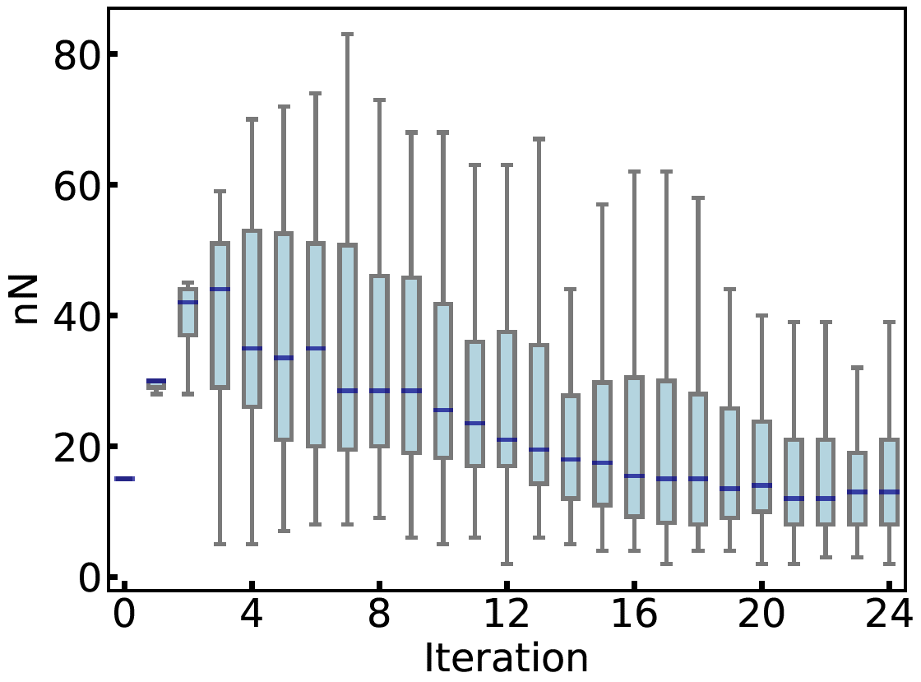
UCI Databases: iris and wine
Sequential copy process was tested with few UCI databases. The simple cases (iris and wine) were successfully copied:
The accuracy remains large even when the copy was using 15 point or less.
N=15
iris database

Slide 8
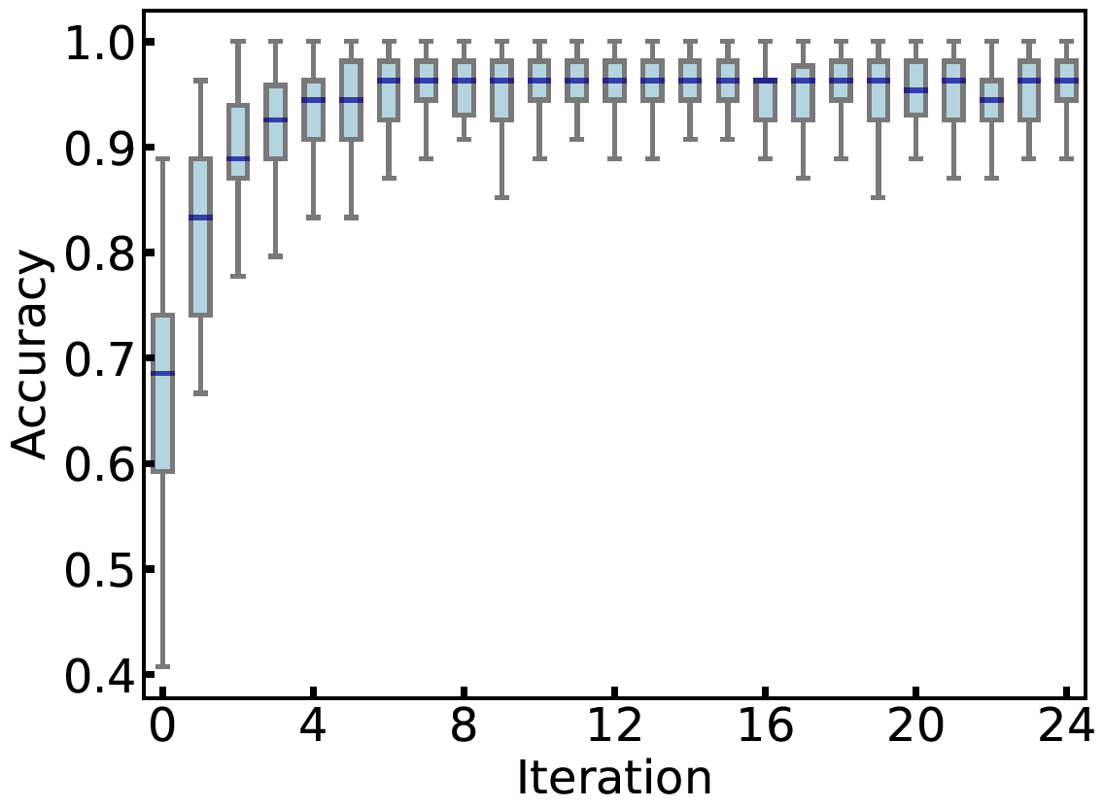
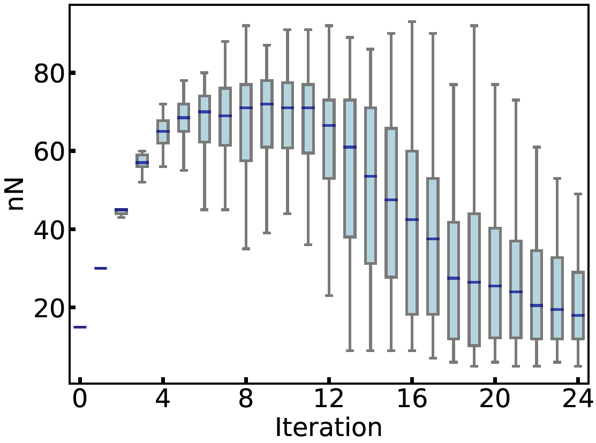
UCI Databases: iris and wine
The shape of the nN plot indicates that the frontiers between classes is more complicated than the previous case. Then more points are needed before start to drop them.
N=15
wine database

Slide 9
UCI Databases: Higher Dimension
Other databases (abalone and covertype) are been studied. However, due to the higher dimensionality, we are dealing with the sampling problem.
Next step: show the performance of the sequential approach with higher dimensional databases

Slide 10
Current Status
01
UCI databases
02
Custom loss and train step functions

Slide 11
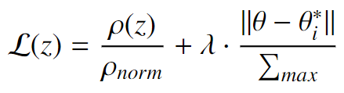
Studying the effect of lambda
1- Point-dependent loss term
2- Regularization term. Avoid the model to shift far away from last best parameters.
3- Lambda: The relation between both terms.
We are still understanding how those terms behaves in different situations. We have not developed a general procedure for the order of magnitude of lambda.

Slide 12
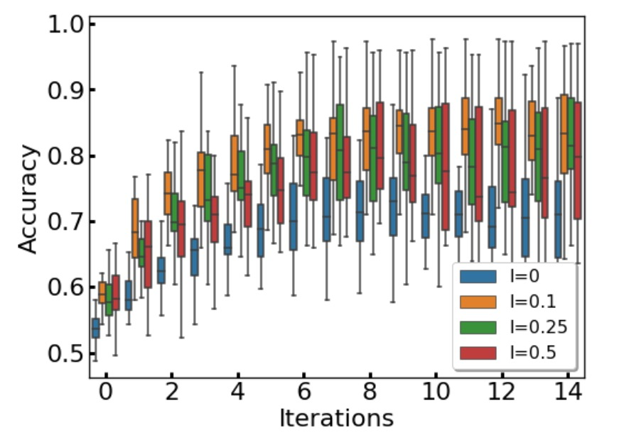
Studying the effect of lambda
Spirals with dropping and using 75 points

Slide 13
04
Next Steps

Slide 14
Next Steps
01
High dimension databases
02
Generalization of the regularization term

